Slide 1



Roy Rosado - 2020

Slide 2
Contents
Background & Challenge
New Solution
Solution Values
Product List
Successful Cases

Slide 3
Background
At the end of 2019, a novel coronavirus, referred to as COVID-19, broke out in Wuhan, China. The virus is characterized by human-to-human transmission, medical staff infection and community transmission. The disease has become a worldwide pandemic.
More than 700 people died in China within weeks of the virus first being identified.
All 50 states have reported cases of COVID-19 to CDC.
Total USA COVID-19 cases: 54,453
Global Deaths 22,029
States Reporting Cases of COVID-19 to CDC
Information as of 3/25/2020

Slide 4
A Faster Alternative….
Thermal Temperature Monitoring Solution
Thermal imaging technology was also used during the SARS outbreak, which also saw high fevers.
Non-contact automatic temperature monitoring. Operators do not have to be near people being screened for higher social distancing.
Accurate, multi-person monitoring. A faster, more sanitary way to identify a person in a large group with an elevated temperature.
Records abnormal temperature information automatically.
Captures person’s identity automatically with facial recognition system feature.

Slide 5
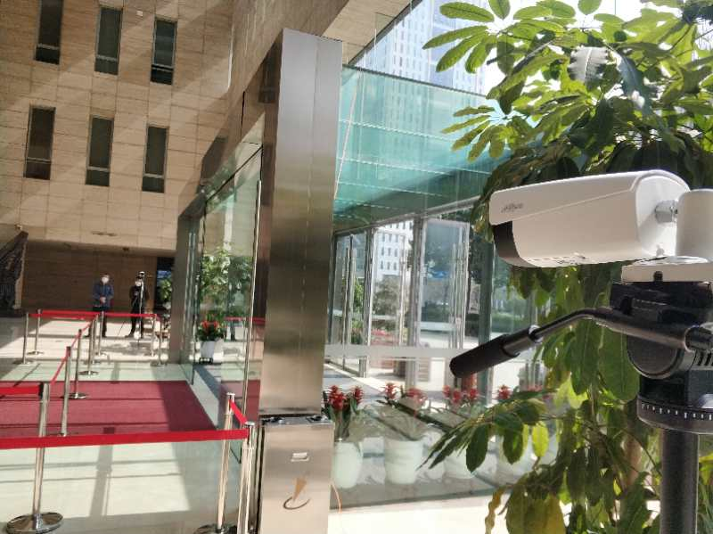
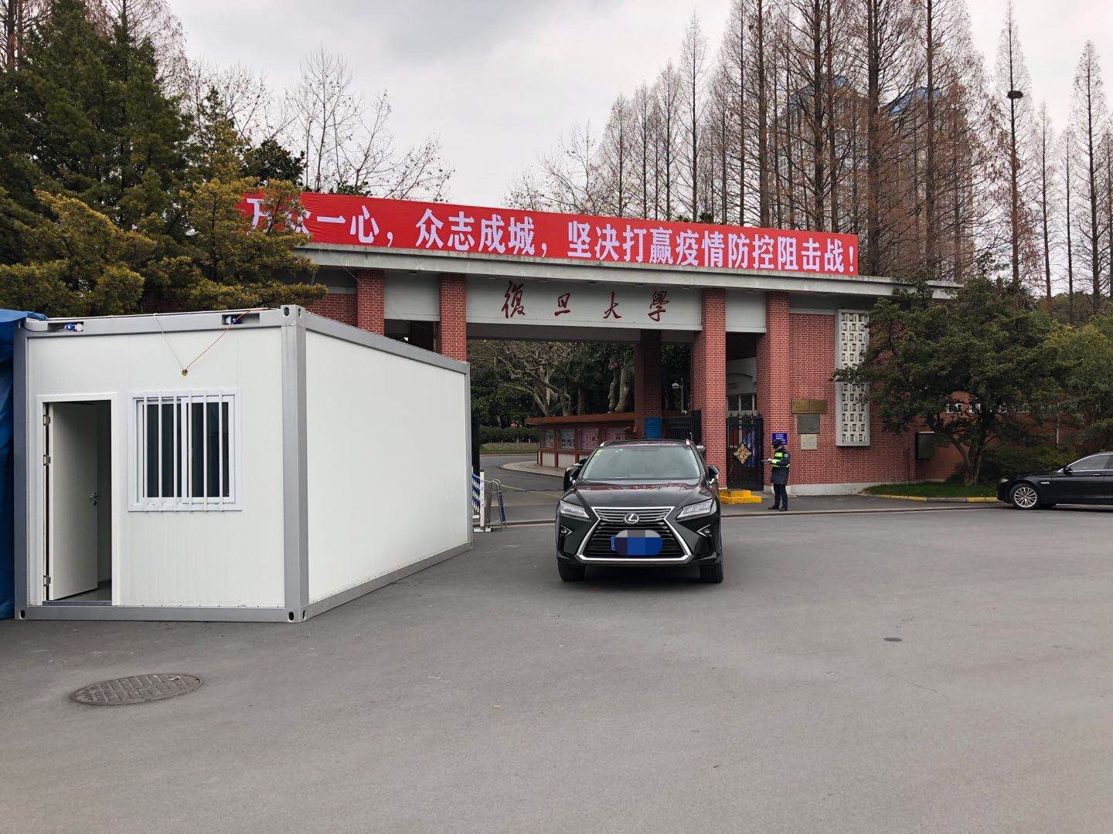
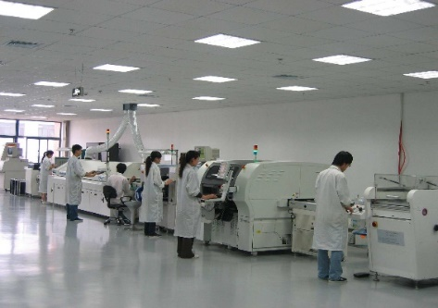
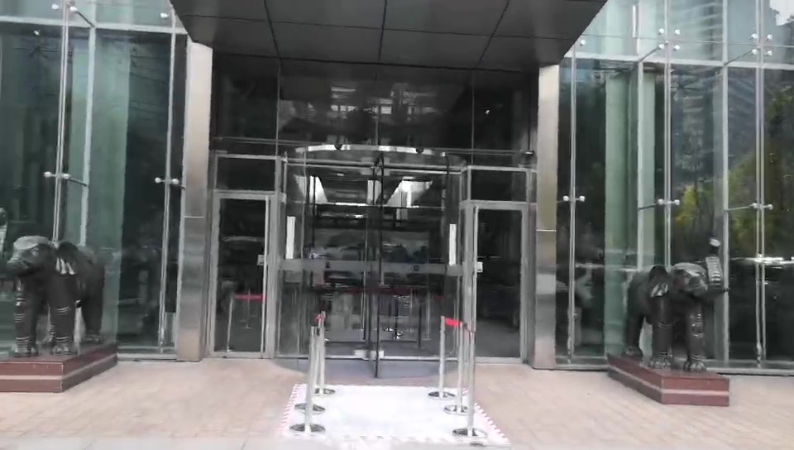

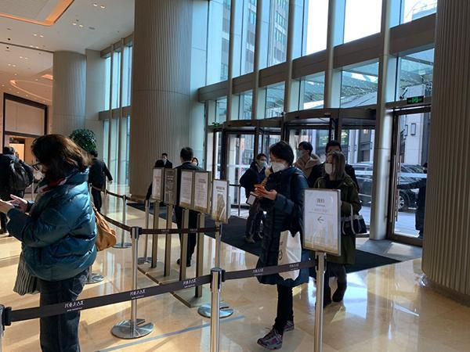
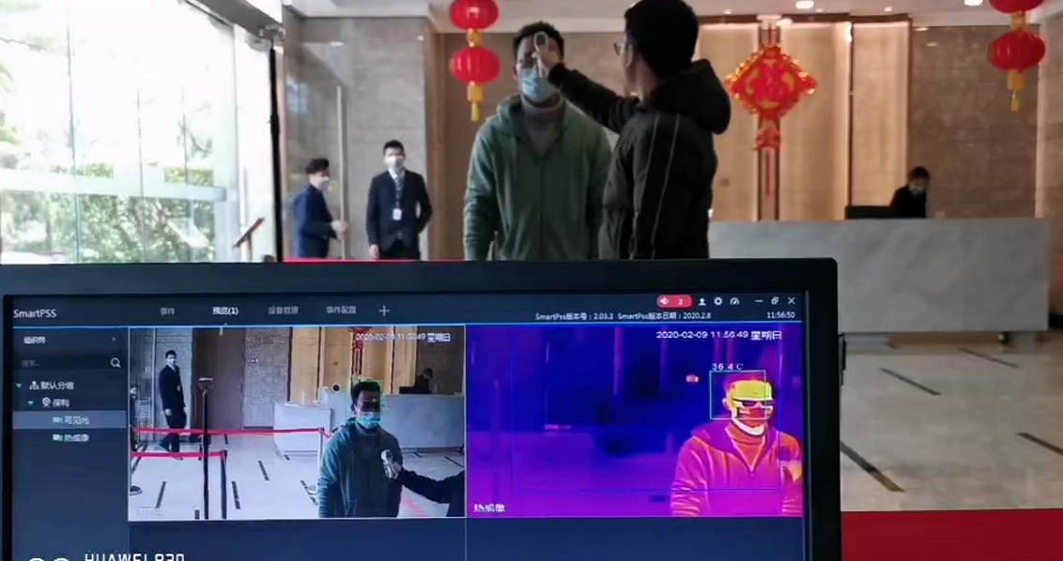
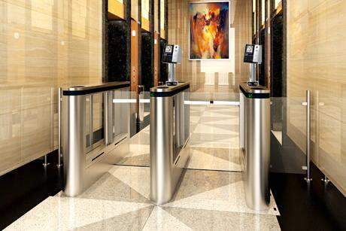
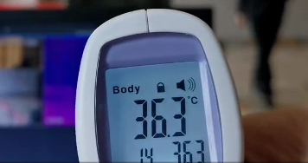
Thermal Temperature Monitoring Solution
Dahua launches the latest thermal camera, which is capable of high accurate body temperature measurement ±0.3℃(with blackbody). Built-in AI algorithm for multi-person measuring up to 3m distance which enables fast and non-contact access.
Scenario
……
Office Building
School
Factory
Hotel
Retail
Sub-scene
……
Entrance
Lobby
Elevator Entrance

Slide 6
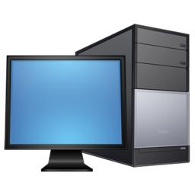
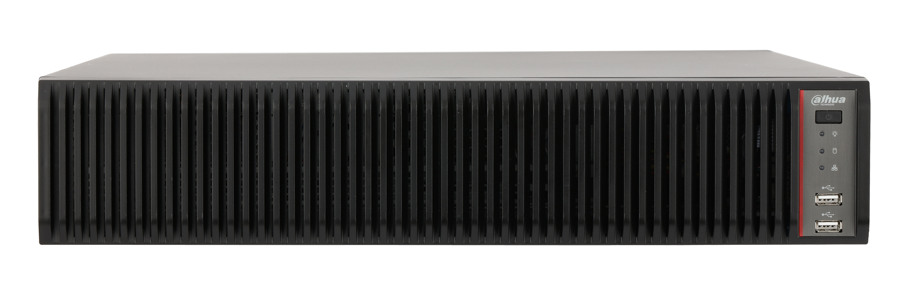
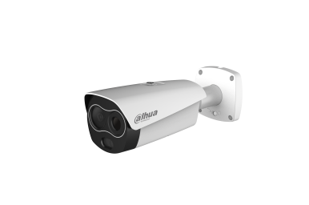
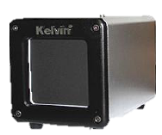

Thermal Temperature Monitoring Solution
Entrance guide area
Isolation area
Temperature Monitoring Area
Normal
Pass
DSS Express or Web page
DHI-IVSS-I
NVR-5X-I
Dss Express or Web Page
Re-inspection
Area
Normal
TPC-BF3221
TPC-BF5421
Temperature calibrator
TPC-BF3221
Temperature calibrator
（Audible and visual alarm）
（Audible and visual alarm）
Economical
Standard
Contact Detection
Denied Entry
Abnormal

Slide 7
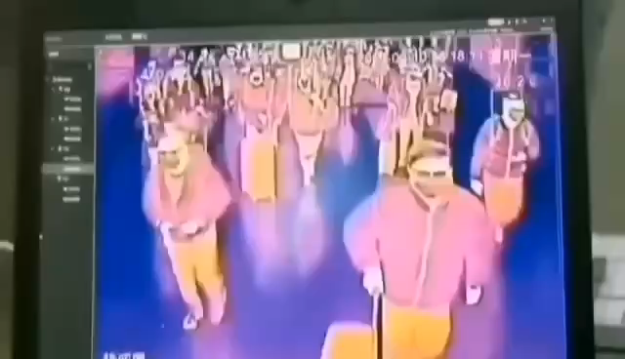
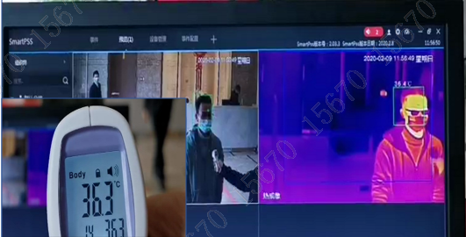
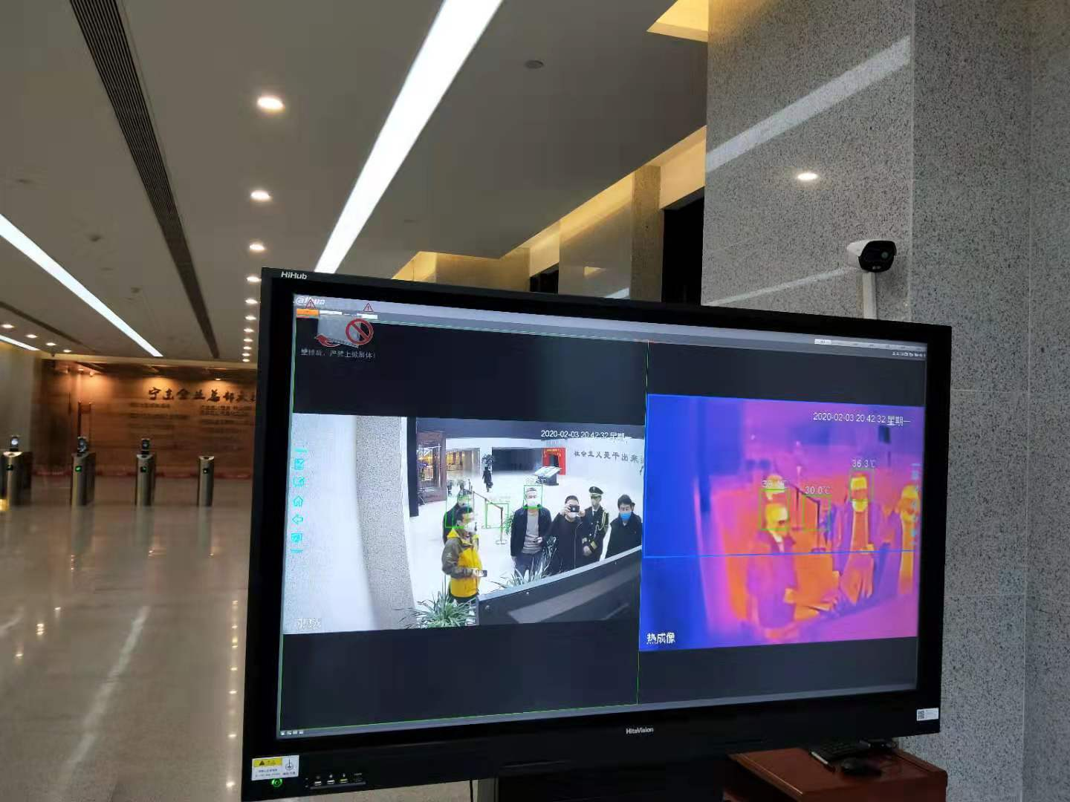
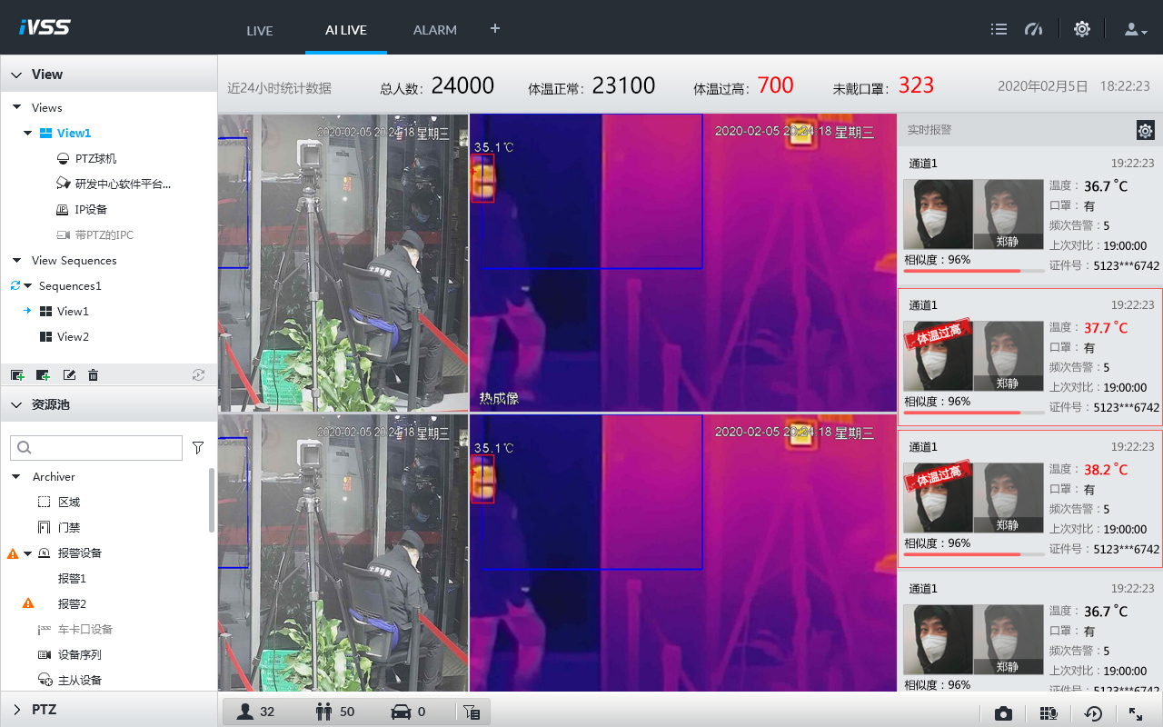
Solution Values
Fast Pass
High Accuracy
People can pass quickly because of the long monitoring distance and wide coverage
±0.3℃（with Temperature calibrator）
Low Cost and efficiency
Facial identification
Alarm automatically, Reduce labor costs and reduce the risk of cross-infection
Facial identification to easily match with alarm

Slide 8
Solution Values
Thermal temperature monitoring solution is a cutting-edge technology that could play a crucial role in monitoring temperatures.
Fast screening without personal contact
Accurate, safe and efficient temperature monitoring
Monitoring of multiple people at the same time for higher efficiency
Visual alert when abnormal results are detected
Facial identification to easily match with alarm

Slide 9
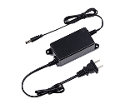
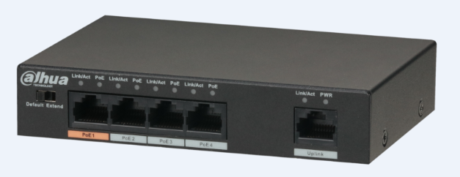
Product List
Serial Number | Products | Models | Picture | Parameter | Remarks
1 | Thermal Network Value Hybrid Bullet Camera | DH-TPC-BF3221 DH-TPC-BF5421 |  | uncooled VOx thermal sensor technology Thermal lens：7mm/13mm Alarm：Built-in white light warning light, horn Temperature monitoring range：30℃～45℃， Temperature monitoring accuracy ：±0.3℃，with blackbody ±1℃，without temperature calibrator
2 | Temperature calibrator | JQ-D70Z |  | Working temperature ：40.0℃（ environment temperature +5.0℃~ 50.0℃） Temperature resolution ：0.1℃ Temperature monitoring accuracy ：±0.2℃（Single point） Power：220VAC 50Hz Ambient temperature and humidity ：0~40℃/ ≤80%RH | One temperature calibrator Need pair with one camera
3 | Camera power | DH-PFM320D |  |  | Optional
4 | PoE Switch | DH-PFS3005-4ET-60 |  |  | Optional

Slide 10
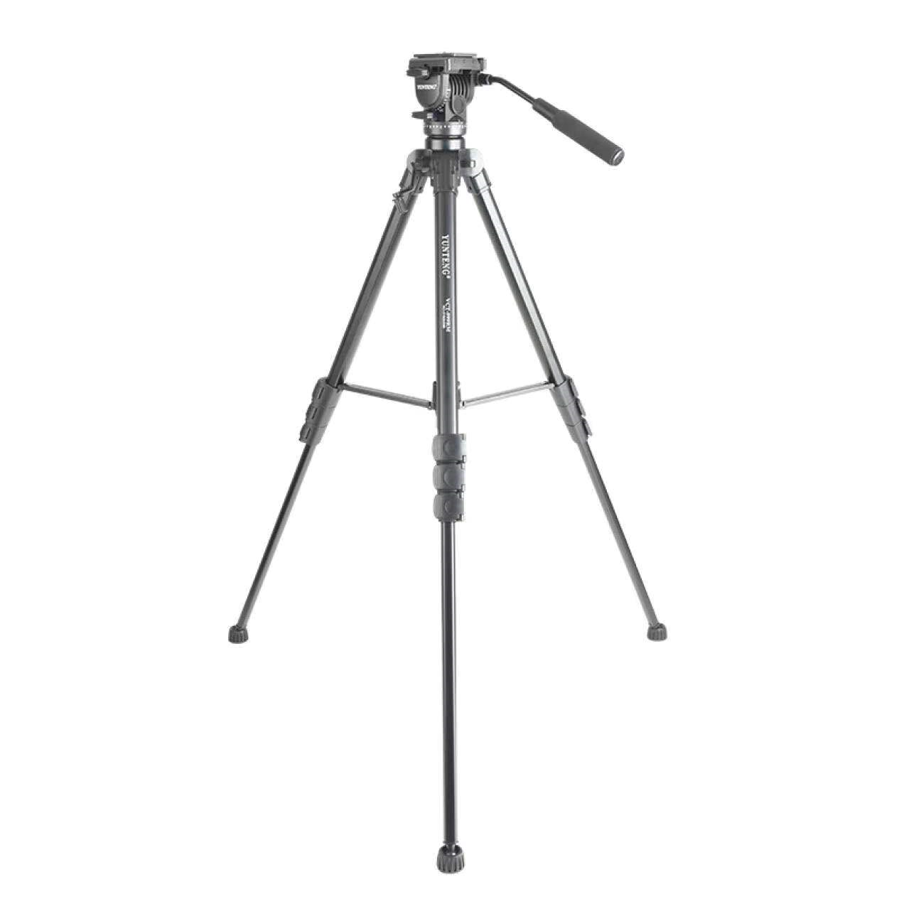
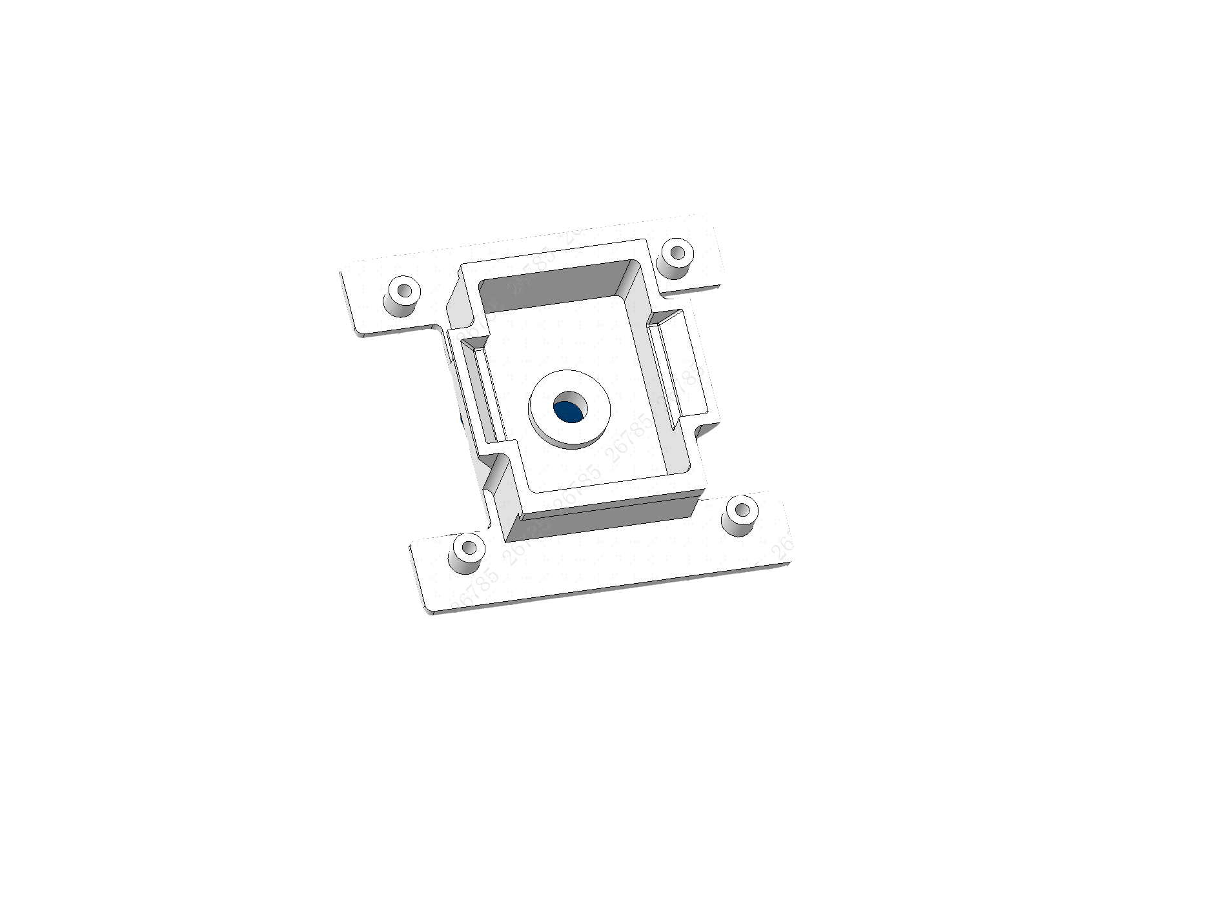
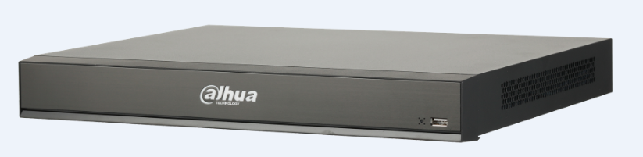
Product List
Serial Number | Products | Models | Picture | Parameter | Remarks
4 | Tripod | VCT-999
5 | Connector | RAW021-00 |  | Connect the camera to the tripod /connect the blackbody to the tripod
 | NVR | DHI-NVR5216-16P-I |  | Support TPC alarm event access and configuration Support TPC alarm real-time display, searching and playback Support 4 channels mask detection Support 4 channels face recognition for identity check | Optional, If the TPC requires POE power, you need to add POE switch separately
7 | Software | DHI-DSSExpress-Base-License |  | Human body high temperature alarm access Alarm event popup prompt Base License includes 64 video channels (32 TPC)
8 | Server | Dell R230 |  |  | Optional

Slide 11

Thermal Dual-lens
Detects the heat from multiple places on the body.
300x400 VOx uncooled thermal sensor technology
Athermalized Lens (thermal camera), Focus-free
Visible: 1/2.8” 2MP progressive scan Sony CMOS
Dual-lens:
• Thermal 13mm / Visible 8mm
    Support Motion Detection, Color Palettes
Support measure body temperature
High Accuracy: Max (±0.3°C, with black-body/ ±1℃，without blackbody)
Built-in 2/2 alarm in/out
SD Card Slot up to 256GB
IP67
H.265
SD
Slot
120dB
Visible Lens
Thermal Lens
IR Light
LED Light
Notes:
Integrated Hybrid Camera
The visual part of the camera records in parallel with the infrared thermal camera so there is a visual and thermal picture to identify the subject. The real-time visual camera stream includes a visual of the Alarmed High Temperature numerical fever reading.
Alarm and Notification
Temperatures above the notification threshold are automatically sent to the web application and mobile application.

Slide 12
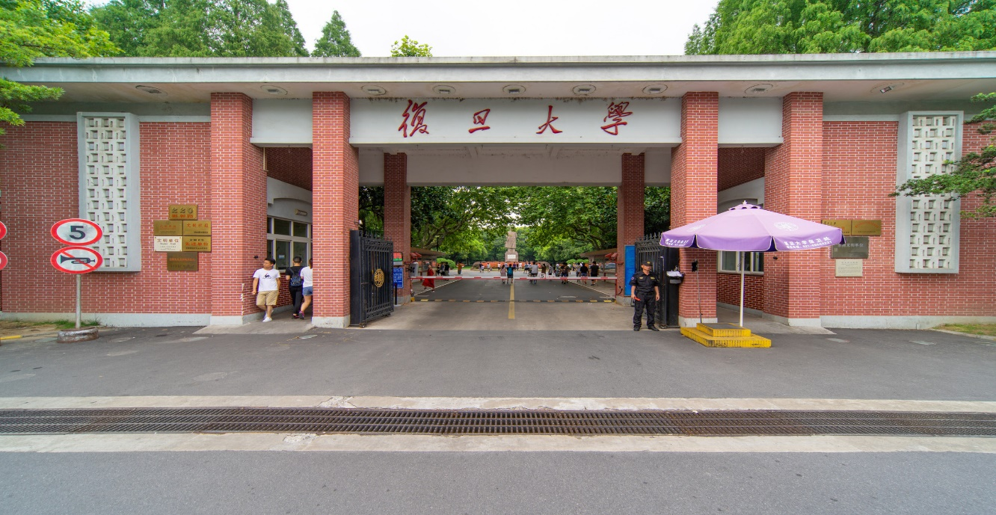
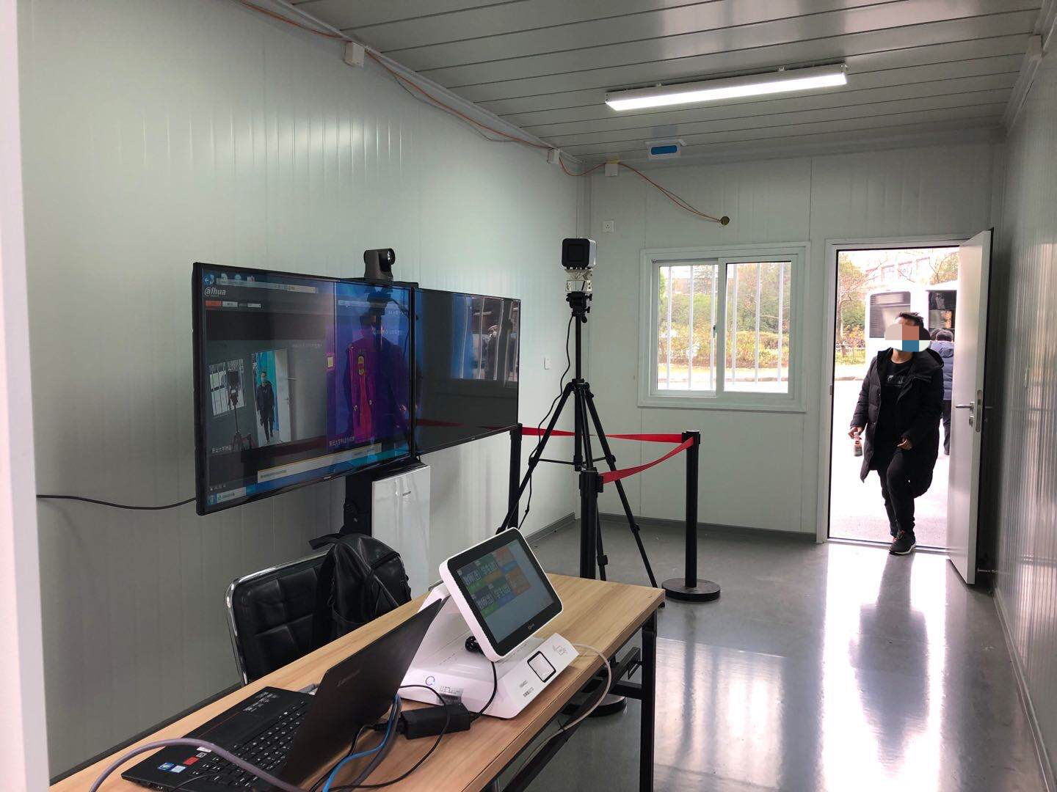
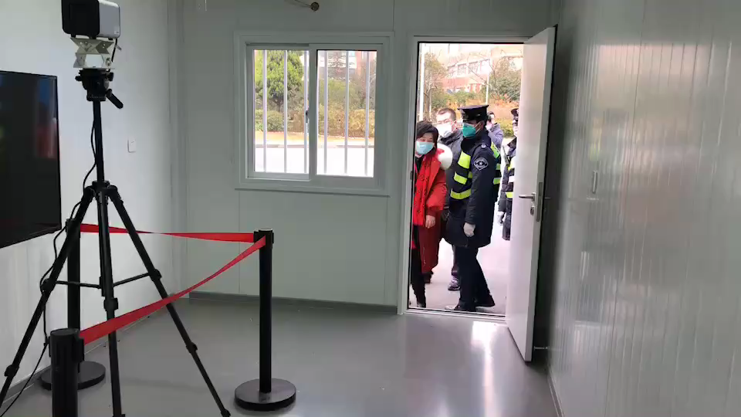
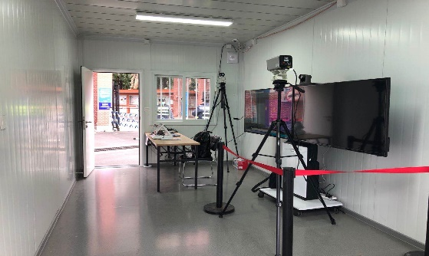
Successful Cases
Fudan University
Dahua’s thermal temperature monitoring solution is helping Fudan University identify people with an elevated temperature. The solution offers ±0.54°F accuracy, decreases screening time, monitors at long distances, and provides wide area coverage for multiple people.

Slide 13
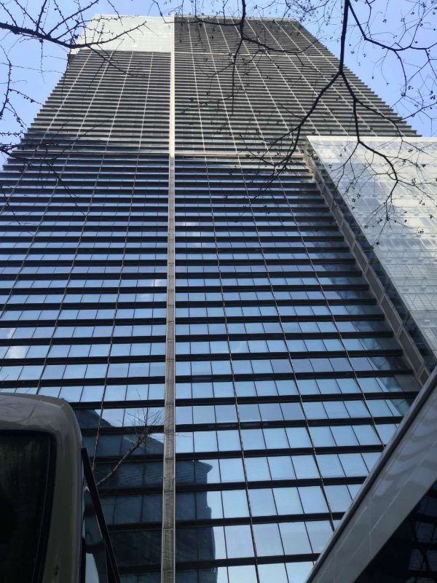

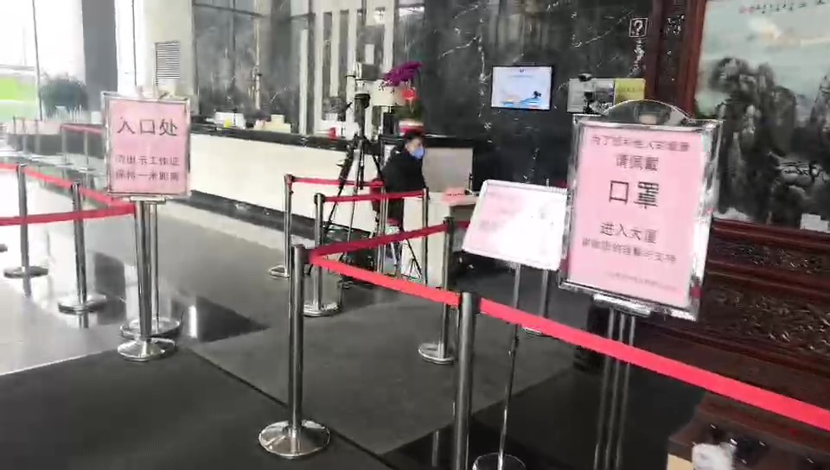
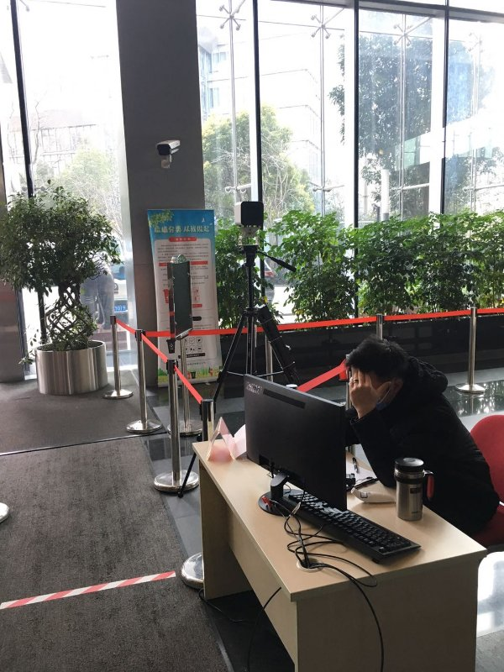
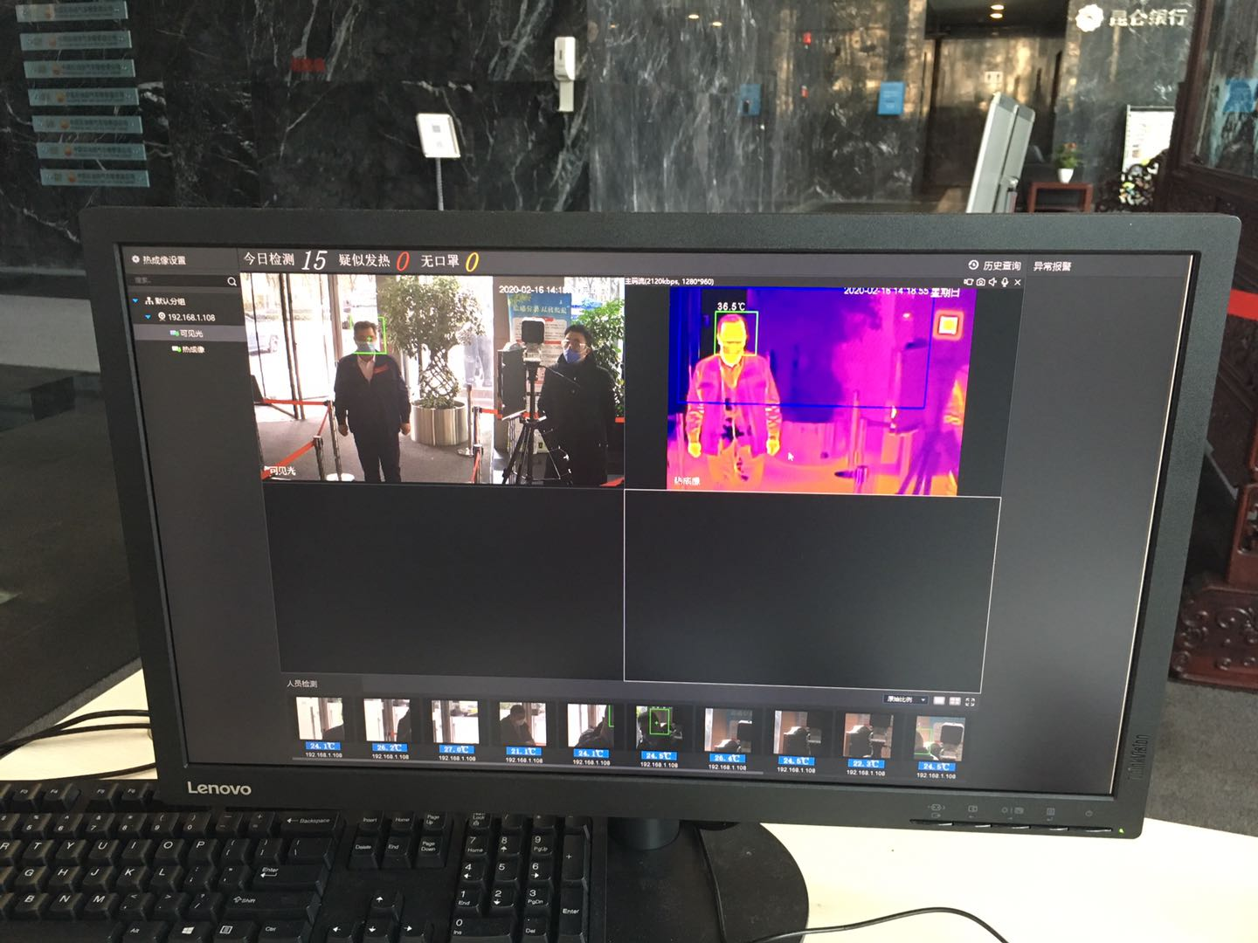
Successful Cases
PetroChina West East Gas Pipeline Company
In order to secure public health, Dahua’s thermal temperature monitoring solution is deployed at the entrance of
the Petro China Shanghai Building. The solution monitors for elevated temperature of personnel entering the building.

Slide 14

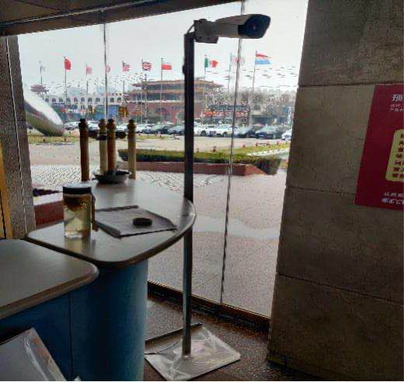
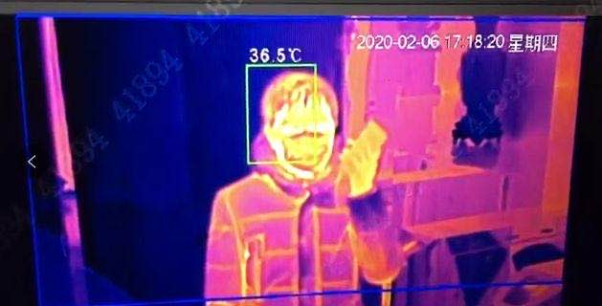
Successful Cases
Shineway Group
Thermal temperature monitoring solution is deployed at headquarters, which screens for elevated
temperatures of employees entering the building.

Slide 15
FDA Approval:
The current solution is not FDA approved.
The camera does not detect COVID-19, and ultimately, only a doctor can determine whether someone's body temperature reflects if they are ill.
Notice:
These products are not medical devices and are not intended for use in the diagnosis, cure, mitigation, treatment, or prevention of any disease or other medical condition.
The Thermal Temperature Monitoring Solution is not for use in identifying or stopping the spread of the COVID-19. Any association with using Dahua devices within the medical industry or for medical purposes is not backed by any viable correlation or research.
This solution is ideal to identify individuals in a population that show higher than average temperature in relation to a sample population. Dahua cameras are not capable of finding individuals experiencing COVID-19 symptoms. There is no way to decipher an infected individual who has no fever and no way of telling if a “hot” individual has a fever or other conditions have contributed to the rise in heat “such as sunburn.”

Slide 16
Thank You

